Slide 1

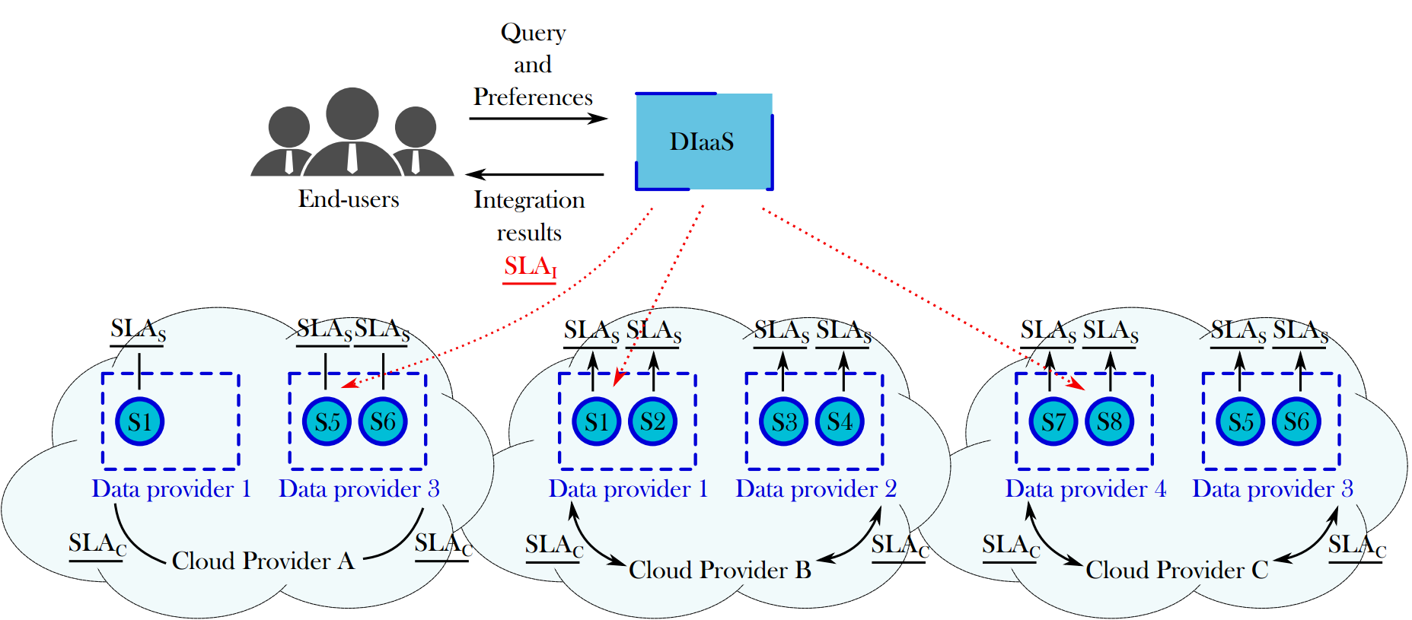
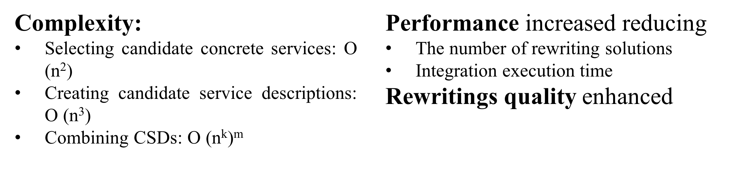
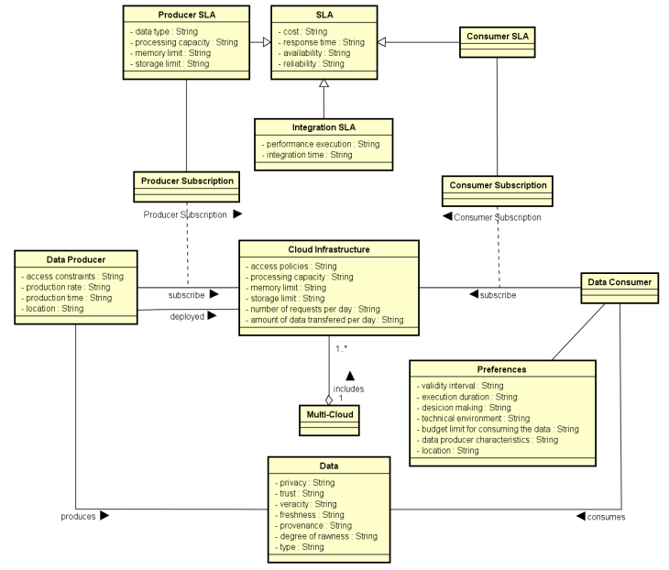
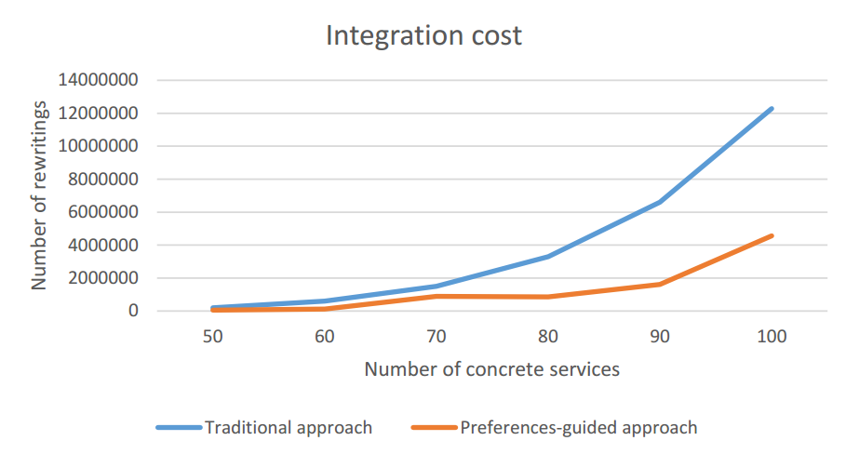
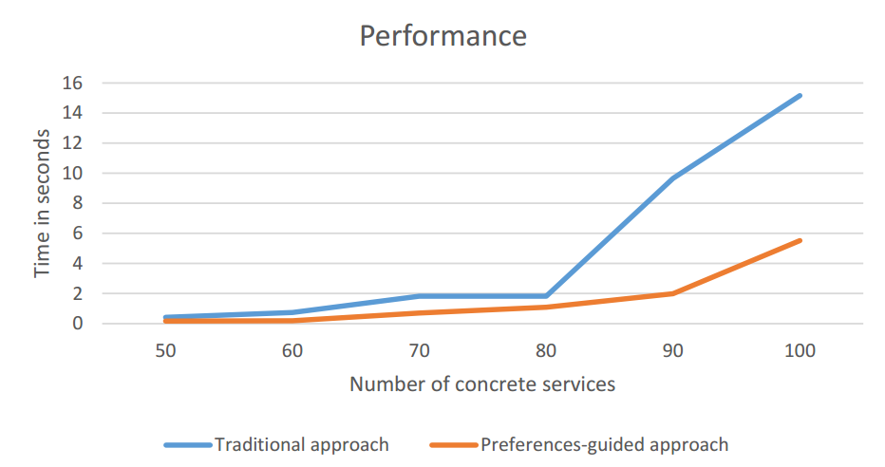
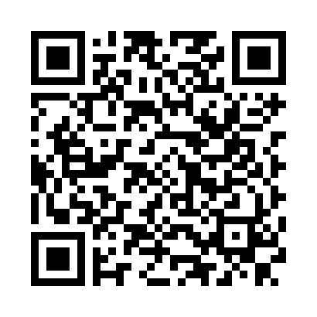



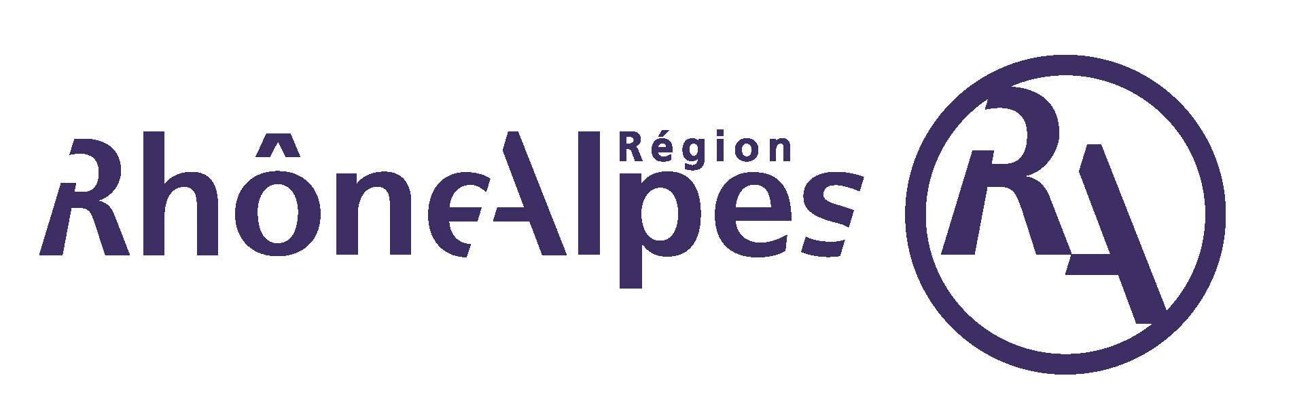
Mondes numériques pour l’humain et la société : conception, comportements et usages
ARC 6 : Technologies de l’Information et de la Communication
et Usages Informatiques Innovants
Trusted SLA-Guided Data Integration on Multi-cloud Environment
The emergence of cloud environments redefined the data integration as a service matching and composition problem. Furthermore, new constraints imposed by multi-cloud environments bring new challenges to data integration
Objective: propose a data integration approach in a multi-cloud environment taking into account data quality properties and service level agreements (SLA)
POINTS CLES
TRAVAUX ENGAGES / RESULTATS
Problem statement and state of the art by applying a systematic mapping process
Rhône algorithm: formalization and implementation of a quality-based query rewriting considering user preferences and quality aspects expressed as SLA contracts (Figure 2)
Experimentation: lessons learned (Figure 3)
Data integration metamodel: a metamodel and metaprocess to address data integration adapted to the multi-cloud context (Figure 1)
Ongoing work:
Designing models for the cloud SLA, service SLA and integration SLA
Reducing the overhead caused by query rewriting:
Taxonomy of query variations for promoting reusability of rewriting results
Heuristics for optimizing the rewriting approach adapted to the multi-cloud context
Evaluation of the overall data integration approach adapted to the multi-cloud context
Model quality measures linked to data and to cloud resources
SLA for guiding the data integration process performed on a multi-cloud
Match data providers (services) to queries for integrating data according to the user requirements and the SLAs
PROBLEMATIQUE
Selecting candidate concrete services
Creating candidate service descriptions (CSD)
Combinig CSDs
Producing rewritings
Efficiently obtain results for queries addressing services deployed in a multi-cloud environment by: (a) Fulfilling user QoS requirements; (b) Respecting subscribed contracts with the involved cloud provider(s); and (c) Respecting services contracts (constraints).
Challenges:
How to be sure that all the agreed SLAs are respected while satisfying the user?
Can my constraints be satisfied? Which services shall I ask for?
How can resources be saved for next query?
How to perform the query rewriting matching services that answer the query and satisfy the quality preferences?
How to integrate different SLA associated to services involved with user’s quality preferences?
Figure 2: Rhone algorithm phases
Figure 3: Evaluation results
Figure 1: Data integration metamodel
Publications
Daniel Aguiar da Silva Carvalho, Magellan, IAE, Univ. J-Moulin Lyon 3 - France
Chirine Ghedira Guegan, Magellan, IAE, Univ. J-Moulin Lyon 3 - France
Nadia Bennani, CNRS INSA-Lyon, LIRIS, UMR 5205 - France
Genoveva Vargas-Solar, CNRS, LIG (UMR 5217) - LAFMIA (UMI 3175) - France

